Slide 1
Census Income Prediction
A Machine Learning Approach

Slide 2
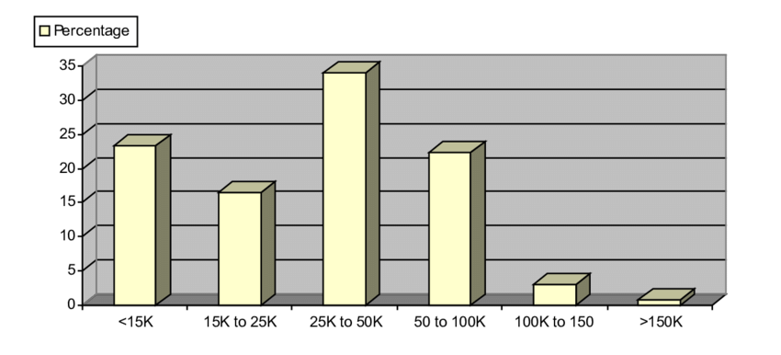
Introduction to Problem Statement
Predicting income levels based on demographic and socioeconomic factors is complex.
Binary Classification: Identify if an individual’s income is above $50,000 or not.
Motivation: Develop multiple machine learning models to determine the best approach for accurate predictions.

Slide 3
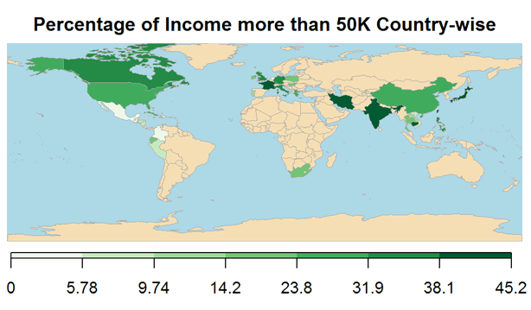
Why This Problem Matters?
Practical applications in policy-making, targeted marketing, and financial planning. (E.g. targeted financial services using income predictions)
Comparative analysis helps in understanding the strengths and weaknesses of the algorithm in a real-world scenario.
Goal: Find the most effective methodology to predict income levels accurately and efficiently.

Slide 4
Literature Review
Paper 1
Paper 2
Adult Income Classification using Machine Learning Techniques
Objective: Applied different machine learning algorithms to the adult income dataset.
Key Findings: Logistic Regression and Decision Trees showed good performance, with Random Forest outperforming them.
Relevance: Provides baseline models and insights for comparison in this project.
Source: IEEE Xplore - Adult Income Classification
A Comparative Analysis of Machine Learning Algorithms for Classification Purpose
Objective: Analyzed various classification algorithms across multiple domains.
Key Findings: Identified trade-offs between accuracy and interpretability (e.g. Neural Networks vs. Decision Trees).
Relevance: Informs our model selection strategy and highlights the need for balancing accuracy and interpretability.
Source: IEEE Xplore - Comparative Analysis

Slide 5

Dataset Description
Overview of the Dataset
Visualization of Key Attributes
Preprocessing Details

Slide 6
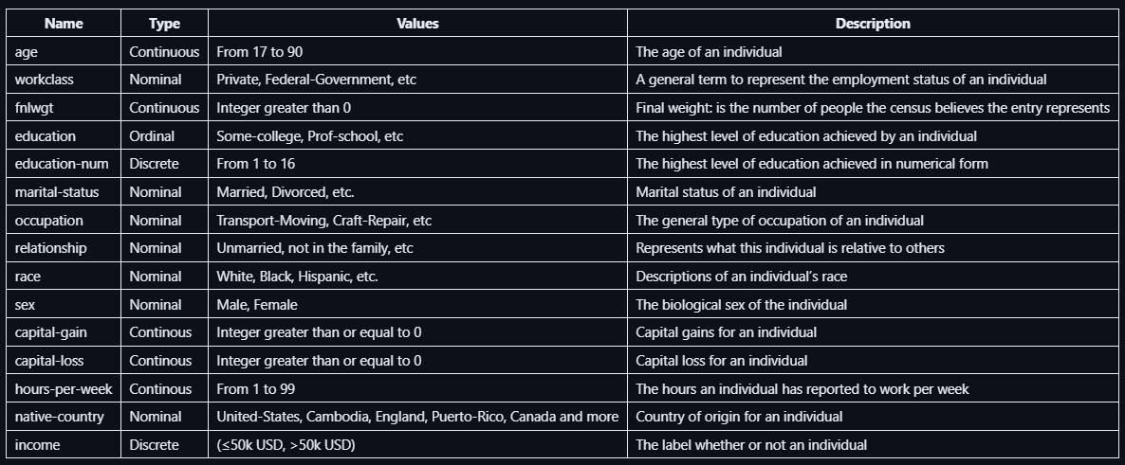
Overview of the Dataset
Dataset Name: Census Income Dataset
Target Variable: Income (Binary Classification: >$50K or <= $50K)
Attributes: age, work-class, education, marital-status, occupation, relationship, race, sex, hours-per-week, capital-gain, capital-loss, native-country, education-num, fnlwgt (final weight) .

Slide 7
Visualization of Key Attributes
Bar Plot: Income, Avg of hours per week, Avg of age for sex
Heatmap: Income vs Education
Histogram: Numerical Features
Box and Violin Plot: Box plot for numerical features and Violin plot for categorical features
Pair Plot: All features

Slide 8
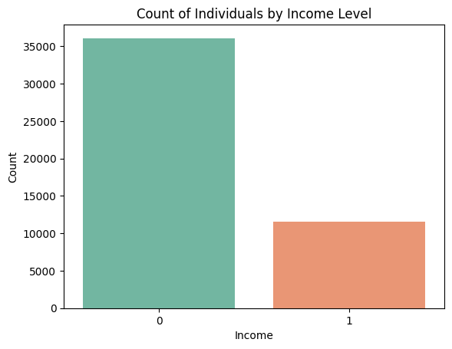
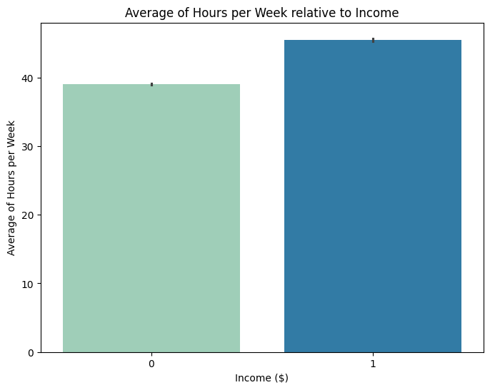
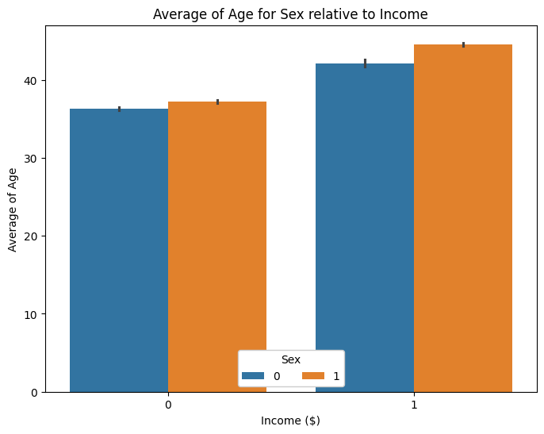
Bar Plots
Income Distribution: Bar plot showing the number of people in different income classes (i.e. > $50K or <= $50K).
Average of Hours per Week vs Income: Bar plot depicting relationship of income growing directly with the average of work hours per week.
Average of Age for Sex vs Income: Bar plot showing that the people with income 50K have a higher average age. With male average age being greater in both cases.

Slide 9
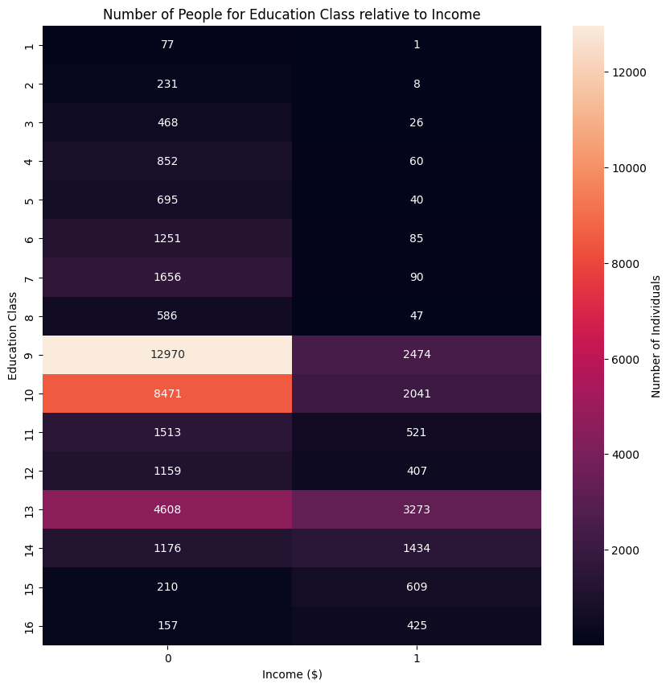
Heatmap
The Income-Education heatmap suggests a strong relationship between education and income.
Notably, the 9th and 10th education levels have the highest counts overall lower income (≤$50k).
While level 13 shows significant representation in both income categories.

Slide 10
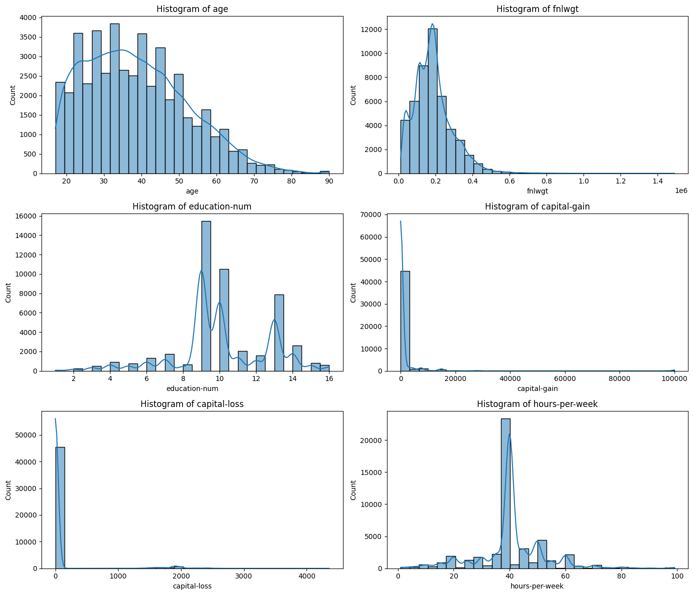
Histogram
Histograms of numerical features:
age: The distribution is right-skewed with most people between 20 and 50 years old.
fnlwgt (final weight): Strongly right-skewed, with the majority of values concentrated below 0.2 million.
education-num: Bimodal distribution, peaking at 9 and 10 years of education.
capital-gain: Highly right-skewed, with most people having zero capital gains.
capital-loss: Most people have zero capital losses, with very few reporting large losses.
hours-per-week: Peaks at around 40 hours, with a concentration of people working between 35-45 hours.

Slide 11
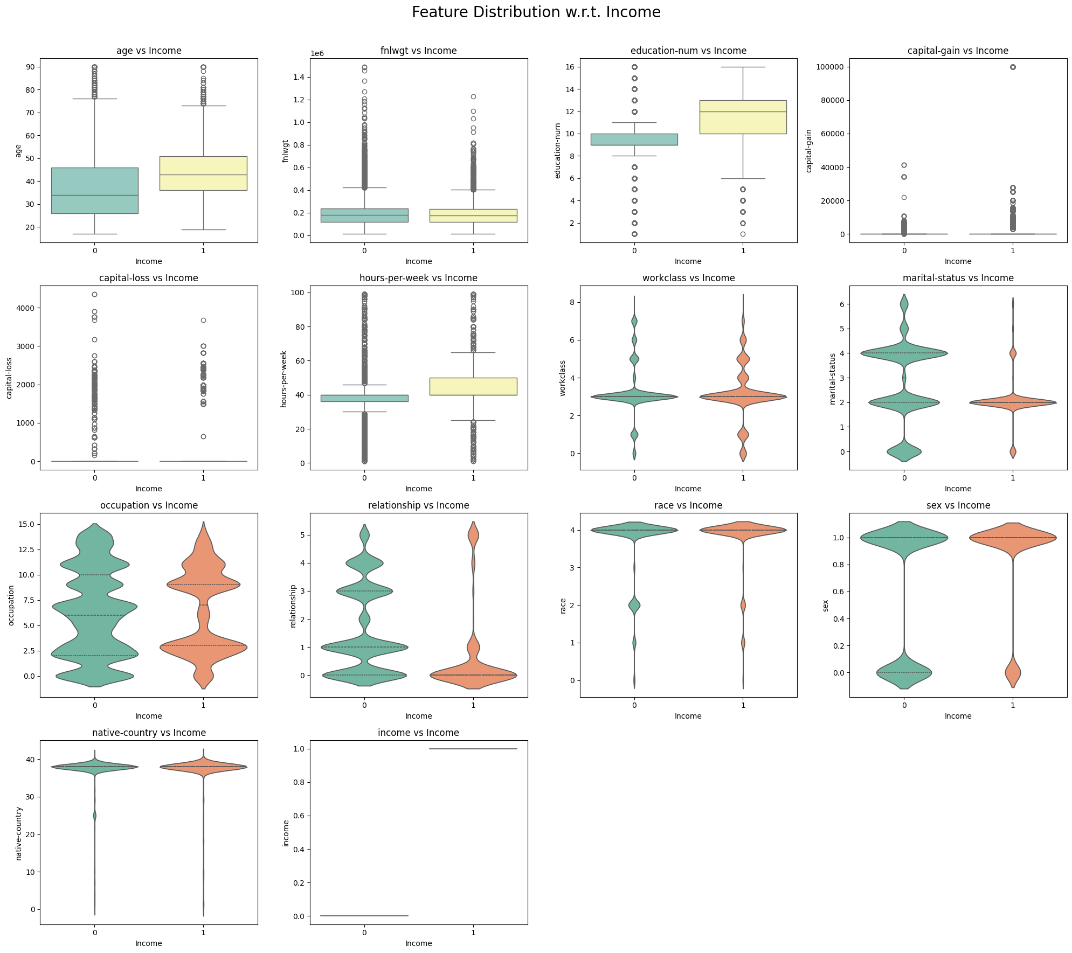
Box and Violin Plot
Key observations w.r.t income:
capital-gain: Strongly correlated with high income, with significant gains in individuals earning >50K.
capital-loss: Higher capital losses also occur more frequently in the >50K income group.
marital-status: Married individuals tend to have higher income, indicating marital status may influence earnings.
occupation: Certain occupations are more prevalent among higher-income individuals.
relationship: Married individuals and specific relationship types are more associated with higher income.

Slide 12
Preprocessing Details
Label Modification:
Fetched Income labels = {'<=50K.’, '<=50K', '>50K.’, '>50K’}
Final modified Income labels = {'<=50K', '>50K’}
Dropped Duplicate Features:
`education` column was duplicate of `education-num`, so we dropped it.
Handling Missing Data:
Dropped all rows with missing value (around 1200 data points from 48k data points).
Encoding Categorical Features:
Applied Label encoding for features like sex, occupation, work-class, etc.
Normalizing Numerical Features:
Applied standard scaling technique to continuous numerical features.

Slide 13

Methodology
Handling Class Imbalance
Model Selection
Initial Model Training
Feature Selection
Train-Test Split
Final Model Training
Hyper-parameter Tuning
K-Fold Cross Validation
Boosting Algorithms
Model Evaluation

Slide 14

Handling Class Imbalance
Problem: Dataset is imbalanced, with approx. 75% of samples in the <=$50K Class.
Solution: Applied Random Oversampling to the minority class, duplicating samples to balance the dataset.

Slide 15
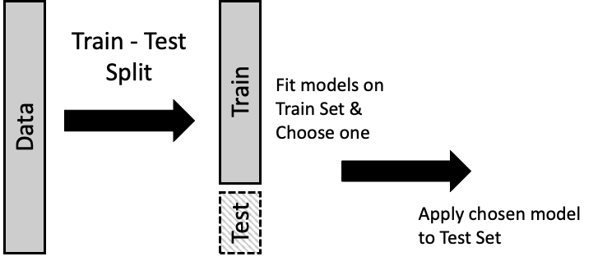
Train-Test Split
Split the data in 80:20 ratio.
80% - Training Set to train the model
20% - Testing set to measure model’s generalization
This split helps avoid overfitting and ensures the model is robust when facing new data.

Slide 16
Model Selection
Models:
Logistic Regression: High interpretability, linear decision boundary.
Decision Trees: Non-linear relationships, risk of overfitting.
Random Forest: Combines multiple decision trees to enhance generalization.
SVM: Handles non-linear decision boundaries using RBF kernel.
MLP Neural Network: Captures complex relationships through multi-layer architecture.

Slide 17
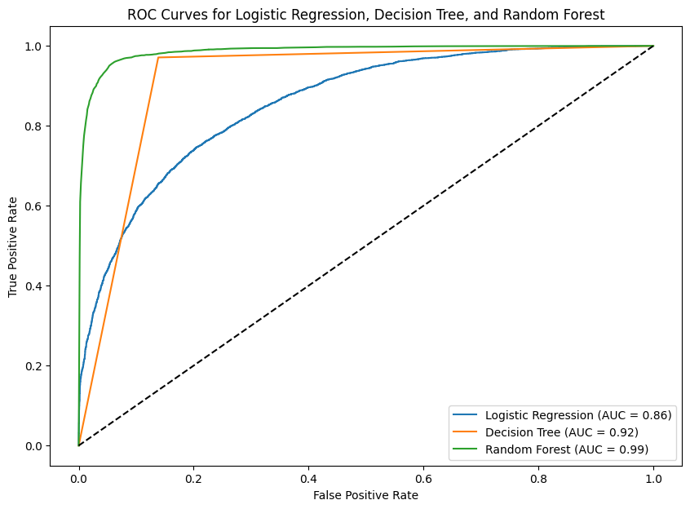
Initial Model Training
Initially, the 3 models selected for training included:
Logistic Regression
Decision Trees
Random Forest
Decision Tree and Random Forest both suffered from overfitting but showed promising validation improvements
Logistic Regression showed underfitting, suggesting it might be too simple for this problem

Slide 18
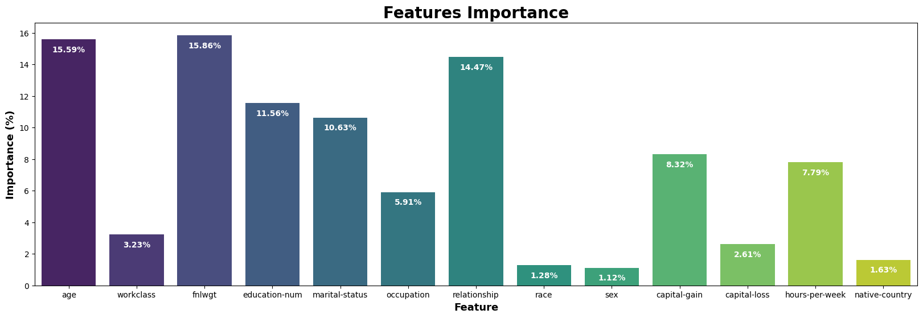
Feature Selection
Visual Representation for Feature Importance

Slide 19
Feature Selection
The most important features influencing income classification (<=50K or >50K) are fnlwgt (15.86%), age (15.59%), and relationship (14.47%).
Features like education-num (11.56%), marital-status (10.63%), and capital-gain (8.32%) also contribute significantly to the model's decision-making process.
Less important features include race (1.28%), sex (1.12%), and native-country (1.63%), suggesting they have minimal impact on the income prediction.
After applying Recursive Feature Elimination (RFE), the top 10 features selected are: fnlwgt, age, relationship, education-num, marital-status, capital-gain, hours-per-week, occupation, workclass, capital-loss.
These features are considered the most significant in predicting income, while features like sex, race, and native-country were excluded, indicating their lesser contribution to model performance.

Slide 20
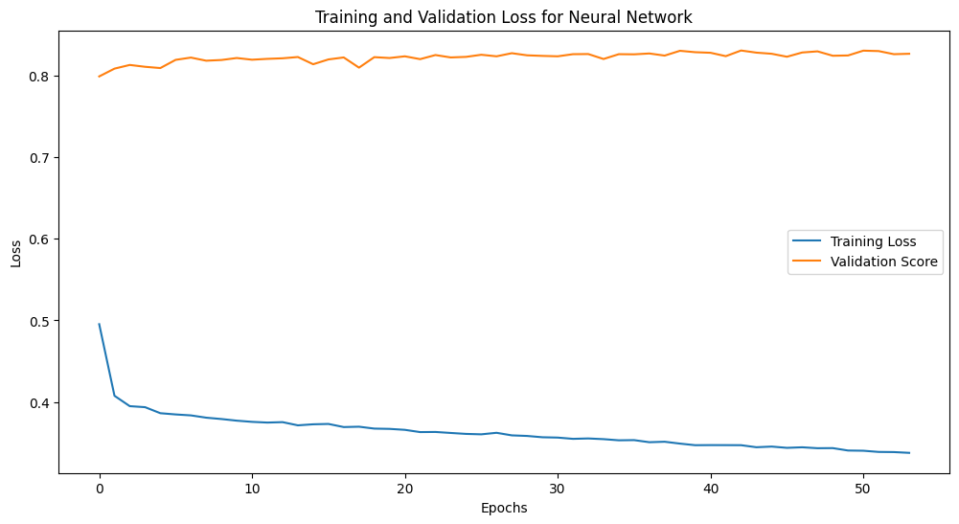
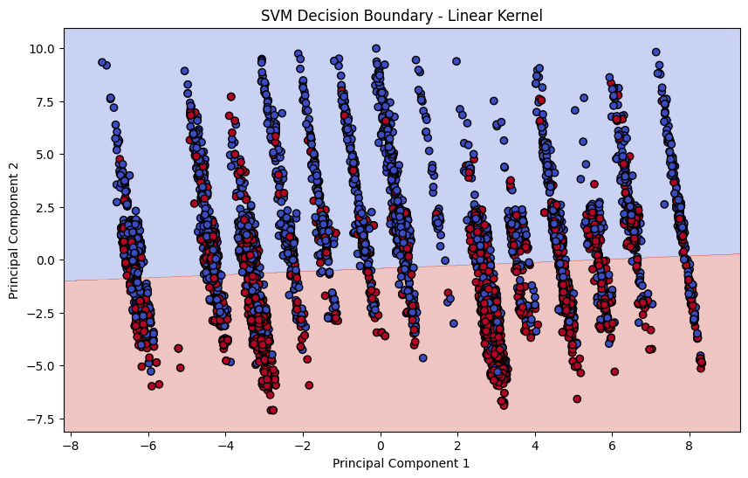
Final Model Training
Final models selected for training:
Random Forest
Neural Network MLP
Support Vector Machine

Slide 21
Hyper-parameter Tuning
Best Parameters for models using Grid Search CV
Random Forest: Achieved Optimal Configuration
bootstrap: False
max_depth: None
min_sample_leaf: 1
min_sample_split: 2
MLP: Optimisation Activation, Hidden Layers, Learning Rate and Regularisation.
activation: relu
alpha: 0.002
hidden layers size: (150,150)
learning rate: constant
solver: adam
SVM: Fine-tuned Kernel Parameters
C: 100
gamma: 1
kernel: rbf

Slide 22
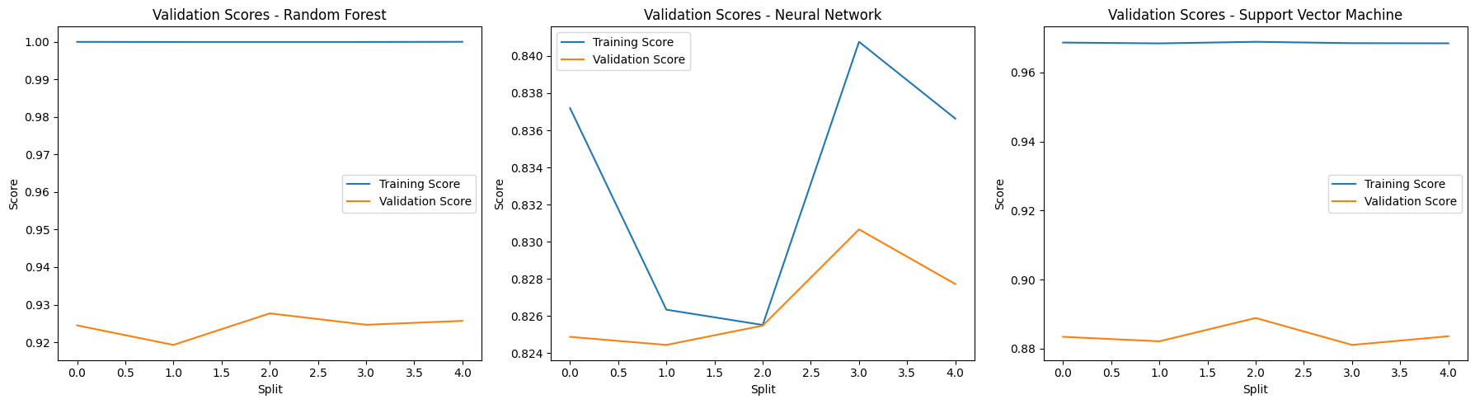
K-Fold Cross-Validation
Random Forest achieved the highest mean cross-validation score of 0.9243, indicating robust generalization across folds.
SVM showed a strong performance with a mean cross-validation score of 0.8838, slightly lower than Random Forest but significantly better than Neural Network.
Neural Network had the lowest mean cross-validation score at 0.8266, suggesting it might not generalize as well as the other models during training.

Slide 23
Model Performance
Performance After Oversampling:
Post Hyper-Parameter Tuning Performance:
Model | Accuracy | F1 Score | Precision | Recall
Logistic Regression | 0.7687 | 0.7697 | 0.7696 | 0.7697
Decision Trees | 0.9165 | 0.9211 | 0.8760 | 0.9710
Random Forest | 0.9336 | 0.9367 | 0.9000 | 0.976
Neural Network | 0.8347 | 0.8400 | 0.8171 | 0.8643
Support Vector Machine | 0.8325 | 0.8417 | 0.9017 | 0.8872
Model | Accuracy | F1 Score | Precision | Recall
Random Forest | 0.9394 | 0.9393 | 0.9410 | 0.9394
Neural Network | 0.8285 | 0.8279 | 0.8321 | 0.8285
Support Vector Machine | 0.8984 | 0.8981 | 0.9016 | 0.8984

Slide 24
Model Performance
Performance After Oversampling
Random Forest: Best performing model with 93.3% accuracy and 0.936 F1-score.
Decision Trees: Showed overfitting with high train accuracy but lower test accuracy
Logistic Regression: Under Fitted the data with 76.8% accuracy.
SVM: Showed high variance with 83% accuracy in training and 68% during testing.
MLP: Performed well in both train and test datasets with nearly 84% accuracy in both .
Post Hyper-Parameter Tuning Performance
Random Forest: Improved to 93.9% accuracy and 0.939 F1-score.
SVM: Achieved 89.8% accuracy, close competitor to Random Forest.
MLP: 82.8% accuracy, less competitive compared to ensemble methods.

Slide 25
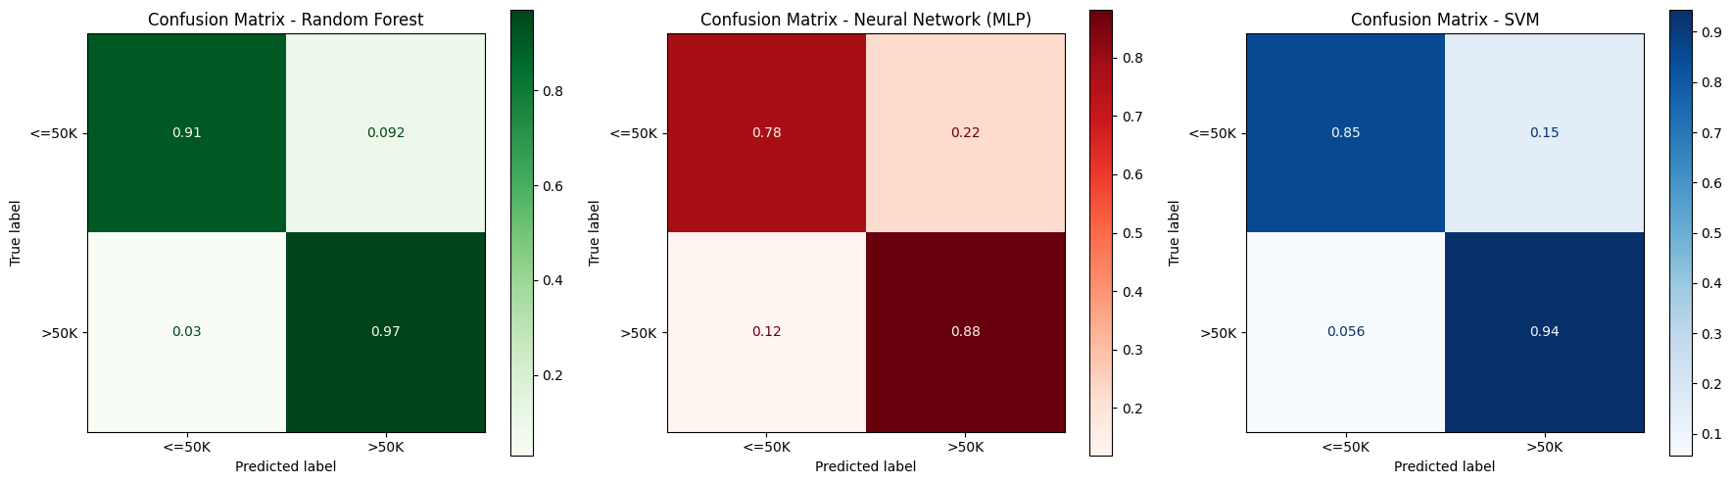
Confusion Matrices
Random Forest: High accuracy, with 91% TPR and 97% TNR, excelling in predicting both <=50K and >50K.
Neural Network: Moderate performance with 78% TPR and higher FPR (22%), struggling with <=50K predictions.
SVM: Balanced performance, with 85% TPR and 94% TNR, but less accurate than Random Forest.

Slide 26
Model Evaluation
Cross Validation Score
Random Forest: Consistently performed well with a mean CV score of 0.924.
SVM: Mean CV score of 0.884, indicating stability but lower overall accuracy.
MLP: Achieved a CV score of 0.827, highlighting areas for further optimization.
Conclusion
Random Forest emerged as the most robust and accurate model for this task, balancing precision and efficiency

Slide 27
Conclusion
Best Performing Model: Random Forest
Random Forest achieved the highest performance with:
i. Accuracy: 93.9%
ii. F1-Score: 0.939
Robust against overfitting, consistently generalizes well across datasets.
Key Takeaways:
Random Forest is highly effective for income prediction tasks involving imbalanced datasets.
Tree-based models like Random Forest and Decision Trees proved highly effective for this complex socioeconomic classification task.

Slide 28
Timeline
Completed Task:
Data collection and preprocessing
Exploratory Data Analysis (EDA)
Model selection and Training
Hyperparameter tuning and advanced model comparison
Final evaluation and report preparation
Presentation and Submission

Slide 29
Individual Team Member’s Contribution
Sameer Singh Godara (2022439): Visualization, Feature selection, Boosting algorithm, Report writing.
Sanyam Barwar (2022447): Preprocessing, Exploratory data analysis (EDA), Final model training, Project management and finalization.
Sanyam Garg (2022448): Data collection, Feature engineering, and Model comparison, Cross-Validation.
Vivan Rangra (2022581): Model Selection, Initial model training, Hyperparameter tuning and Presentation preparation.

